Slide 1
🧠 Alzheimer's Disease Visualization Project
A Data Analysis and Visualization Project

Slide 2
📊 Project Overview
• Analyzed 2,000+ patient records related to Alzheimer Disease.
• Goal: uncover trends in Alzheimer’s diagnosis.
• Focus: demographics, cognitive assessments, ethnicity, family history.
• Built an interactive visualization dashboard using Flask & MongoDB.

Slide 3
Data Overview
Data Storage and Processing
Tools
Source: Kaggle - Alzheimer’s disease CSV dataset
Records: 2149 patients
Features: 29 columns
MongoDB Integration: - Inserted data into MongoDB
Cleaning Steps:
Handled NaNs (na_values, missing columns dropped)
Encoded categorical variables using LabelEncoder
Python, Pandas, Matplotlib, HTML/CSS
Interactive visualization dashboard using flask and mongodb

Slide 4
Why this data set?
- We chose this dataset because Alzheimer’s disease is a growing concern worldwide, and understanding it better can really make a difference.​
- This dataset includes important details about patients — like their age, gender, race, and medical conditions such as diabetes and hypertension.​
These factors are known to be linked to Alzheimer's risk.​
- By exploring this data, we aim to uncover patterns that could help with early detection and more targeted care.

Slide 5
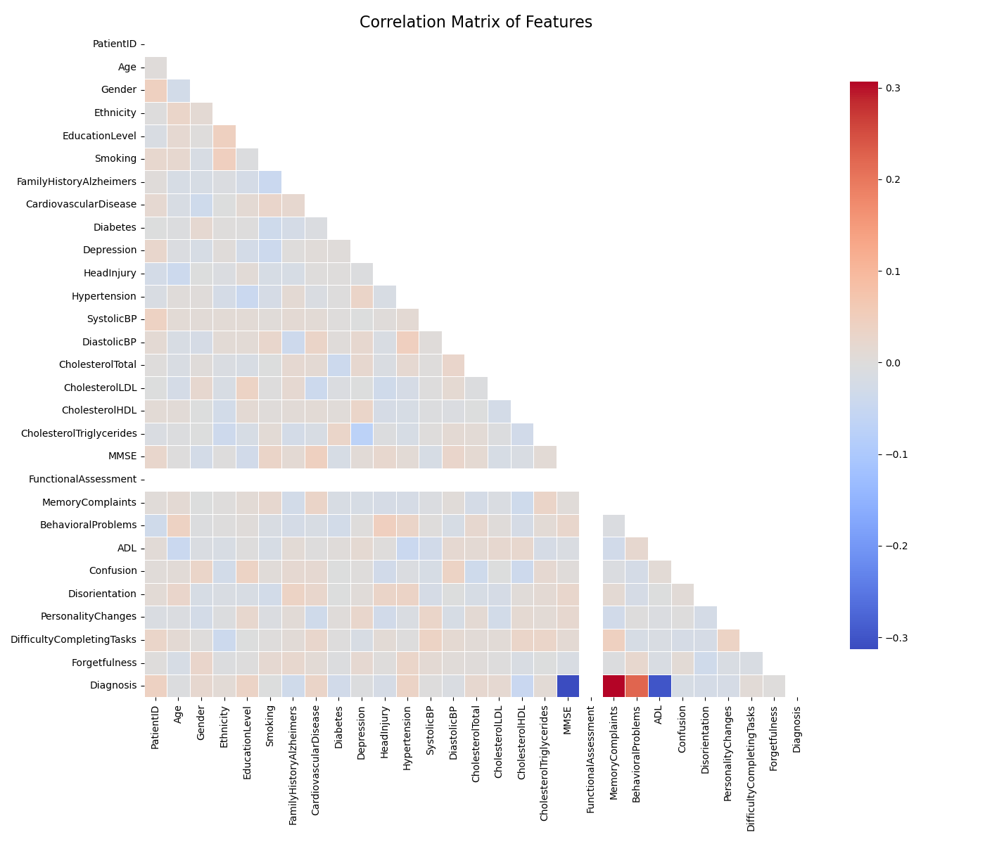
Correlation Matrix of Features
Observations:
- Strong positive correlations appear between age and diagnosis status, possibly due to higher Alzheimer’s risk with increasing age.
- Diabetes, BMI, and cholesterol levels may show moderate correlations with each other, suggesting a metabolic syndrome pattern.
- MMSE score is likely negatively correlated with Alzheimer’s diagnosis, as cognitive decline is measured by MMSE.
Potential Insight: You might want to flag highly correlated variables if you're planning on using regression or machine learning models to avoid multicollinearity issues.

Slide 6
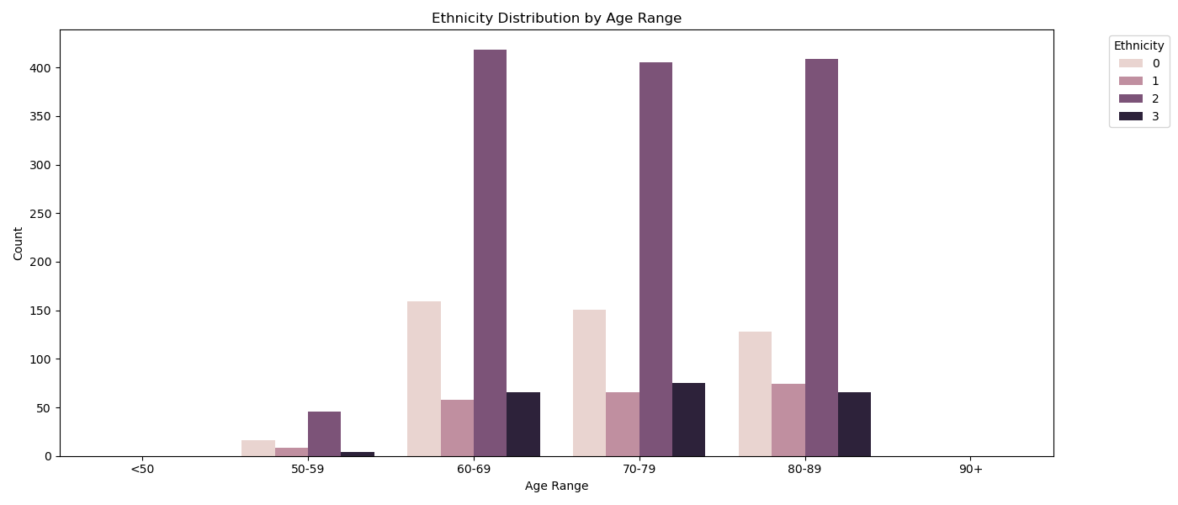
Ethnicity Distribution by Age Range
Observations:
- It appears that some ethnic groups are more represented in older age brackets than others.
- This could be due to demographic trends, socioeconomic status, or healthcare access differences.
Insight: Could influence the fairness of any predictive models or bias the interpretation of disease prevalence by ethnicity.
Notes:
1. Ethnicity Distribution by Age Range {0: 'White', 1: 'Black', 2: 'Other'},
Purpose: Shows the distribution of different ethnic groups across various age ranges.
X-axis: Age ranges (<50, 50-59, 60-69, 70-79, 80-89, 90+).
Y-axis: Patient count (ranging from 0 to 400).
Key Observations:
The highest patient count (close to 400) appears in the age range 60-69 or 70-79, suggesting a peak in middle-aged to older adults.
Younger age groups (<50) and the oldest (90+) have significantly fewer patients.
Ethnicity categories are not explicitly labeled but are likely represented by color segments in each bar (not visible in the text).

Slide 7
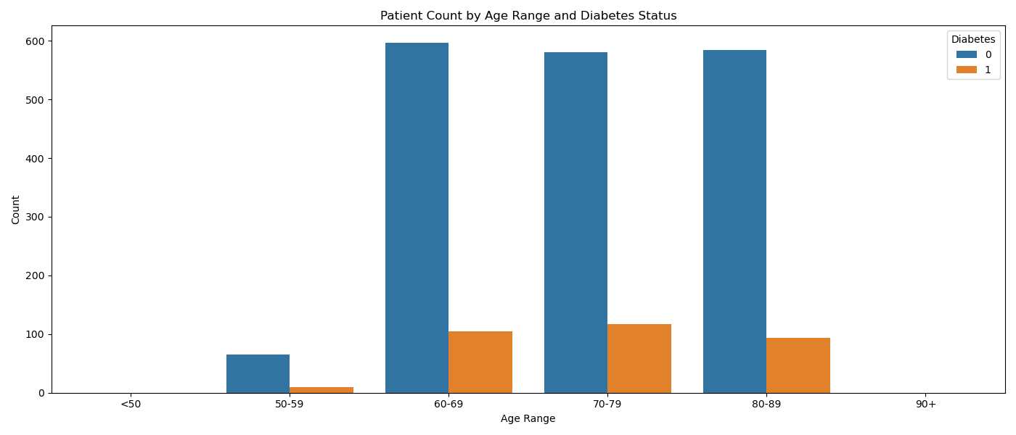
Patient Count by Age Range and Diabetes
Observations:
- Diabetes appears more prevalent in mid-to-older age ranges.
- There might be a peak in diabetes cases in 60–70-year-olds, which then tapers off (possibly due to comorbidities reducing lifespan).
Insight: Useful for studying diabetes as a risk factor for Alzheimer’s or cognitiv
Notes:
Purpose: Displays the relationship between age, diabetes status (0 = No, 1 = Yes), and patient count.
X-axis: Age ranges (<50 to 90+).
Y-axis: Patient count (exact numbers not provided).
Diabetes Status: Represented by two categories (0 and 1).
Key Observations:
Diabetes prevalence (1) likely increases with age, peaking in the 60-69 or 70-79 range.
Younger groups (<50) have fewer diabetic patients.
Non-diabetic patients (0) may dominate in the youngest and oldest age groups.

Slide 8
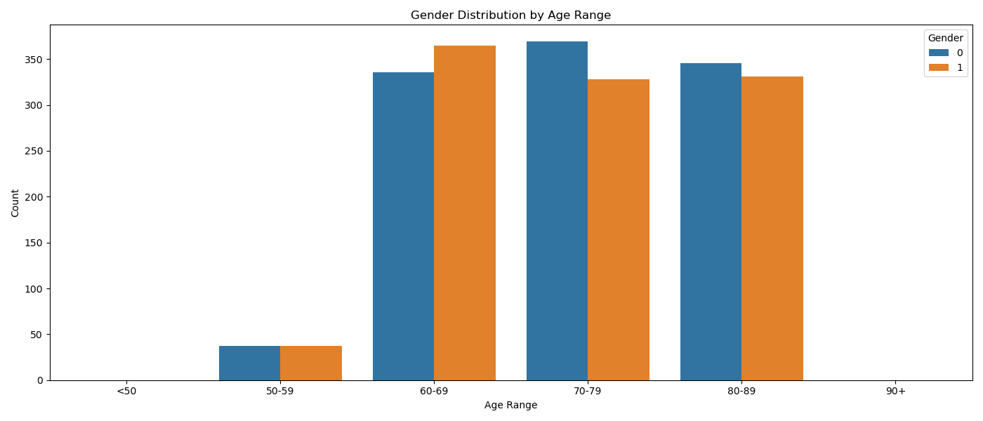
Gender Distribution by Age Range
Observations:
- Possibly a higher proportion of females in the older age groups, which is consistent with general population trends due to female longevity.
Insight: Any age-related outcomes (like Alzheimer's diagnosis) should consider this gender skew.
Notes:
2. Gender Distribution by Age Range 0=male,1=female
Purpose: Illustrates the distribution of genders (likely 0 = Female, 1 = Male) across age ranges.
X-axis: Age ranges (<50, 50-59, 60-69, 70-79, 80-89, 90+).
Y-axis: Gender (binary, with 0 and 1 as categories).
Key Observations:
The chart is likely a stacked or grouped bar plot, but exact counts are missing.
Gender proportions appear balanced in most age groups, though the oldest (90+) might skew toward one gender (often female).

Slide 9
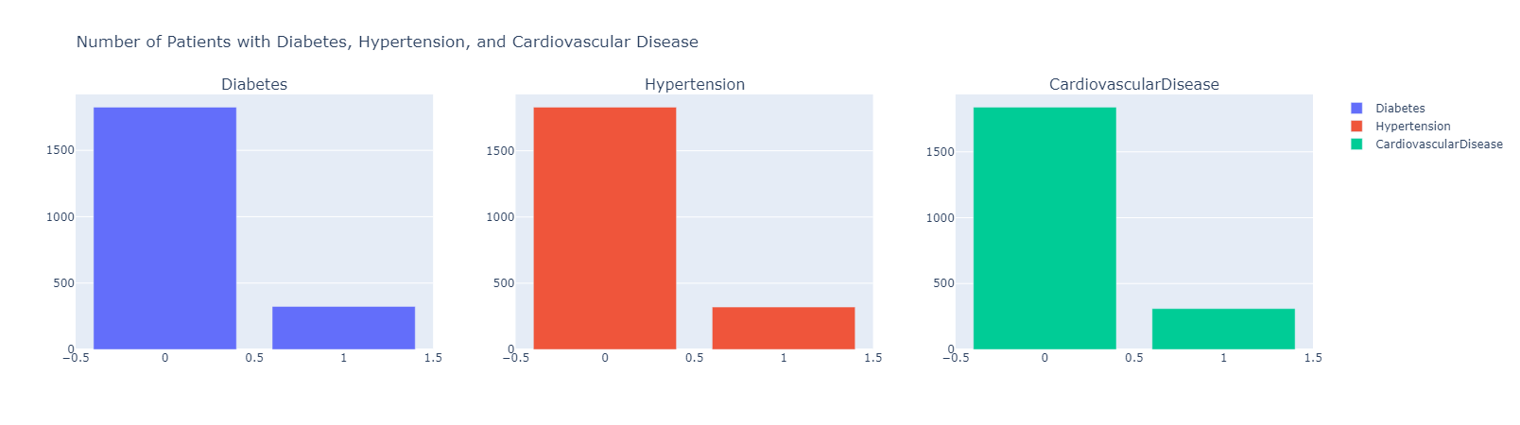
What comorbid conditions (e.g., diabetes, hypertension, cardiovascular disease) are most common among diagnosed patients?

Slide 10
Conclusion
In conclusion, we found that age is the most important risk factor for Alzheimer’s disease.​
Many patients also have other health problems, like diabetes and heart disease, which are common among Alzheimer’s patients.​
Females in age ranges between 75-84 are more affected.​
There are also some differences in ethnicity when it comes to age groups.​
Our charts helped us see these patterns clearly and understand how important early detection and health awareness can be."

Slide 11
Thank You!
Group 5
Haby Sarr,
Krishna Sigdel,
Rache Morris,
Esteban Ortega
Questions?

